Slide 1

1994 Adult Census Data
Income Analysis

Slide 2

The Dataset
https://www.kaggle.com/datasets/mosapabdelghany/adult-income-prediction-dataset
Demographic and employment-related attributes of individuals from the 1994 U.S. Census database

Slide 3

Questions
What demographics were most likely to make more than $50,000 annually in 1994?
  Age Groups
  Sex/Gender
  Level of education
  Race
  Country of origin

Slide 4
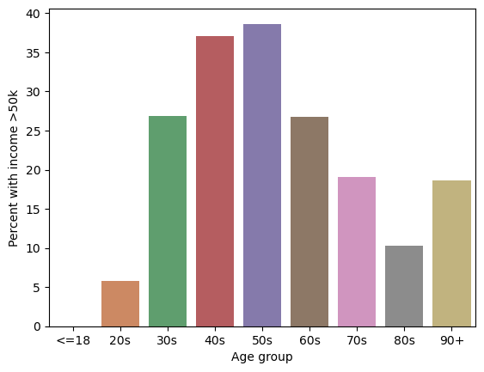
Income by Age group

Slide 5
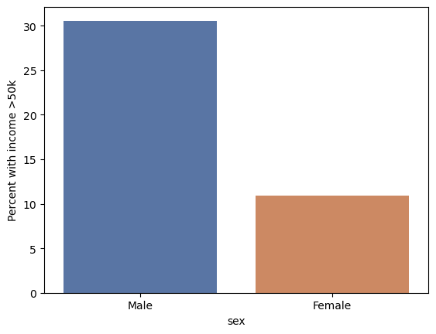
Income by sex

Slide 6
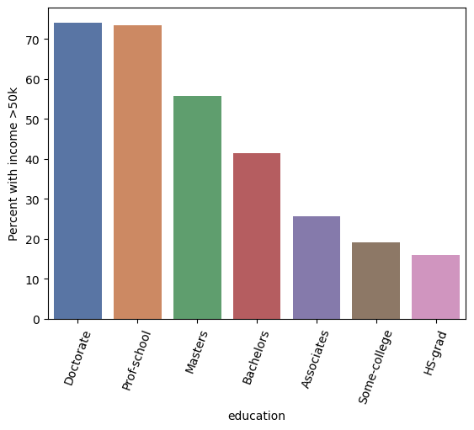
Income by education level

Slide 7
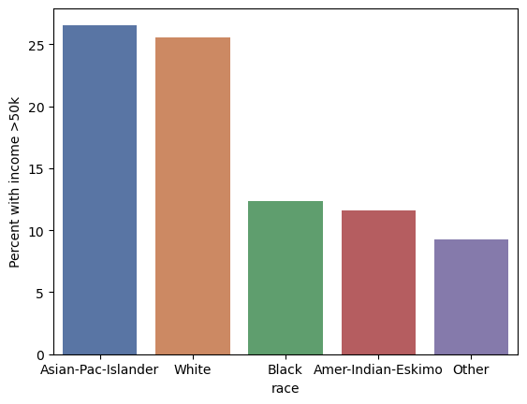
Income by Race

Slide 8
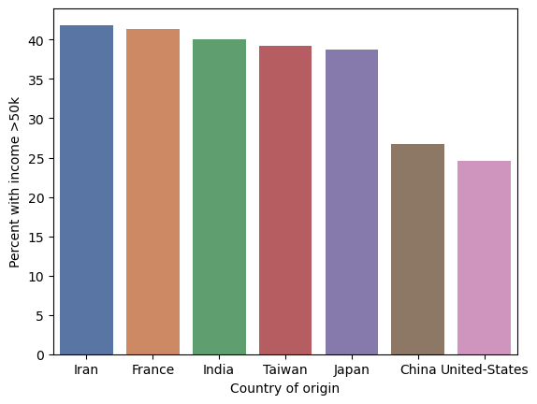
Income by country of origin

